Slide 1
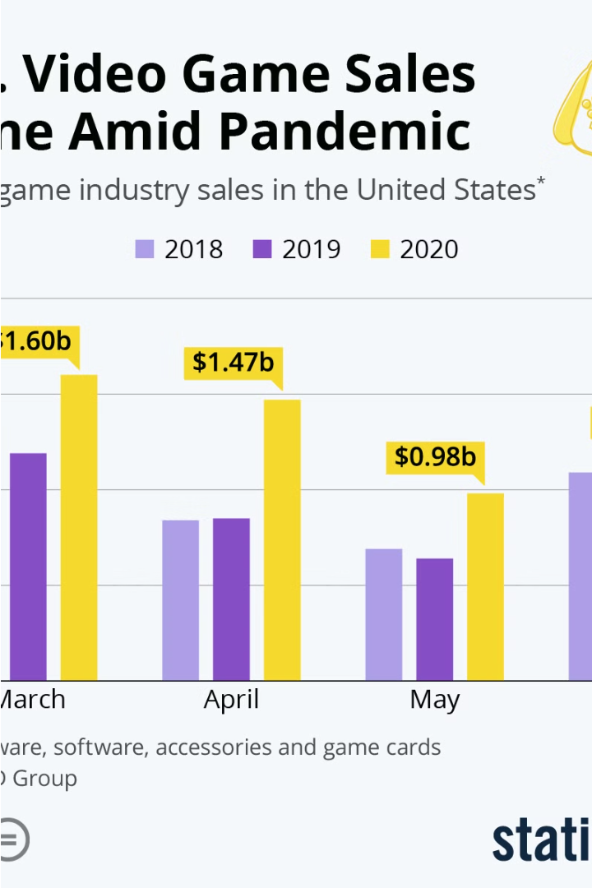
Introduction to Video Game Sales Prediction
The video game industry is a rapidly growing and highly competitive market. Accurately predicting video game sales is crucial for publishers to make informed decisions, optimize marketing strategies, and ensure the long-term success of their products.

Slide 2
Data Sources and Collection
Industry Reports
Sales Tracking
User Feedback
Collect data from industry reports and analyst publications to understand market trends and consumer preferences.
Gather historical sales data from various platforms, retailers, and distribution channels to analyze past performance.
Incorporate user reviews, social media sentiment, and online discussions to gauge audience reception and excitement.

Slide 3
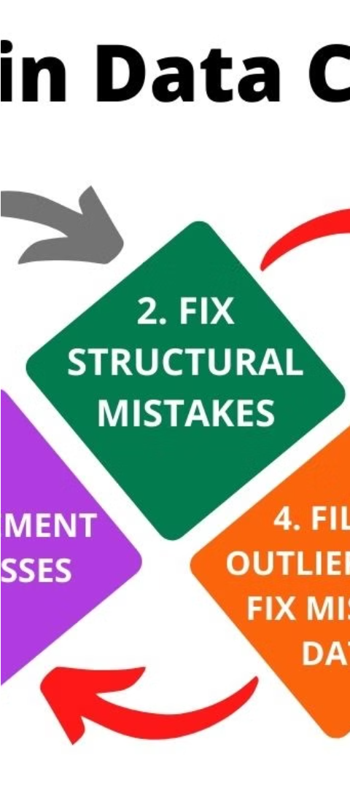
Data Preprocessing and Cleaning
1
Data Normalization
2
Handling Missing Values
Standardize data formats, units, and scales to ensure consistent and accurate analysis.
Employ techniques such as imputation or exclusion to address incomplete or erroneous data points.
3
Feature Engineering
Create new relevant features from the raw data to improve the predictive power of the models.

Slide 4
The Importance of Video Game Sales Prediction
1
Accurate sales forecasting helps video game publishers and developers make informed decisions on production, marketing, and distribution strategies.
Predicting sales trends allows companies to optimize inventory management, reducing costs and maximizing profitability.
Sales prediction models can identify high-potential titles and guide investment decisions, ensuring resources are allocated efficiently.
Accurate forecasts enable proactive planning for post-launch support, downloadable content, and future product development.
Sales prediction insights can help tailor marketing campaigns and launch strategies to maximize the commercial success of video games.

Slide 5
Exploratory Data Analysis and Visualization
Correlations and Drivers
Trend Analysis
Explore the relationships between various factors, such as marketing campaigns, game reviews, and release timings, to understand their impact on sales.
Identify long-term and seasonal sales patterns, capturing the dynamics of the video game market.
1
2
3
Market Segmentation
Analyze sales data across different genres, platforms, and target demographics to uncover unique consumer behaviors.

Slide 6


Machine Learning Model Development
Regression Models
Random Forest Regressor
Utilize linear or non-linear regression techniques to predict the sales volume of video games.
It combines the predictions of multiple decision trees to reduce overfitting and improve accuracy.

Slide 7
Conclusion and Future Work
Key Takeaways
Future Considerations
Industry Impact
Summarize the main findings, the value of accurate video game sales prediction, and the importance of data-driven decision-making.
Highlight how the developed models and insights can benefit video game publishers, developers, and the broader industry.
Discuss potential areas for improvement, such as incorporating real-time data, exploring advanced AI techniques, and expanding the scope of the analysis.

